Slide 1

Data Analysis For Football English Premier League Season 2019-2020 Match Data

Slide 2

Background Information + Goals
Match Results for the whole 2019-2020 season.
Would like to find if there are any specific relationships between the data.
What meaningful insights can we gain from it?
Which team is worth investing in?
What footballing factor is worth betting on? i.e. wins, points, cards etc.
Which team’s results are so successful that selecting players from their team is beneficial to your FPL team?

Slide 3
Intended Audience
Betting Company to help work out odds.
Fans.
Punters.
Team Football Analytics Dept – monitor season. Performance.
Sports TV Channel/Websites.
Referee’s Association – Performance.
Fantasy Premier League Players.
Potential Investors.

Slide 4
Problem Statement
Questions that potential stakeholders would like to know the answer to :
Q1) How many points did each team accumulate at the end of the season?
Q2) Are you more likely to win points if you play at home?
Q3) What were the cumulative Gameweek points of Top 2 teams - Liverpool and Manchester City?
Q4) Which referee(s) were most prolific in handing out red and yellow cards?

Slide 5
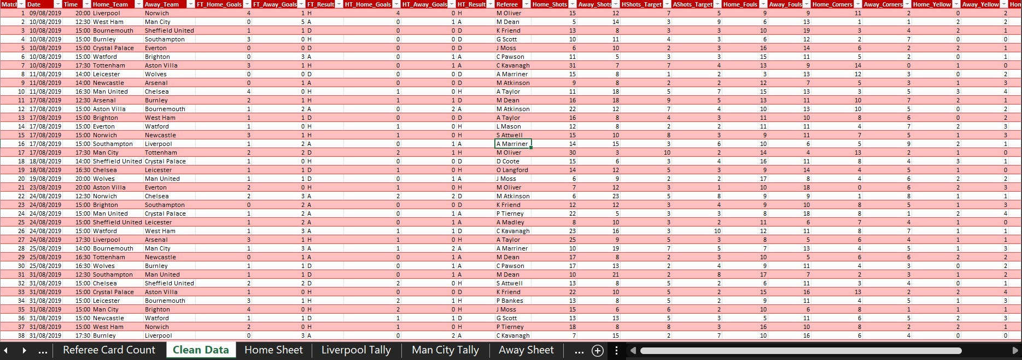
The Data In Question & How I Solved It
Make sense of invaluable data Match Results Data taken from football-data.co.uk.
Cleaned it accordingly to give a clearer and more organised dataset.
Filtered it, created more sheets.
Made a VLOOKUP rule and IFS statements to reference the individual cells and tally up the home and away score.
Created a rule for 3 points for a win, 1 point for a draw and 0 points for a loss.
Make a Premier League points chart for that season.

Slide 6
1) how many points did each team accumulate? And who Won the League Title?
Liverpool won the league title with 99 Points.
Although Linear dotted line in the charts suggests that the charts Man City were the 2 run away challengers.
Stakeholders would be wise to bet on both to win or challenge for the league for the next season.
Rival teams may even want to look into which teams to scout for players.

Slide 7
2) Are you more likely to win points if you play at home?
Based on observation the charts there seems to be a slight trend of approx. 60:40 in favour of the no. of home points against no. of away points
The points tally for home and away matches would suggest that home advantage is more favourable than away matches with higher points overall and on average
A trend of higher % home points in for smaller teams ie Watford, Norwich and Aston Villa – worth looking into if you’re placing a bet
Team | Sum of Total Home Points | Sum of Total Away Points | Total Sum of Points
Liverpool | 55 | 44 | 99
Man City | 47 | 34 | 81
Chelsea | 36 | 30 | 66
Man United | 37 | 29 | 66
Leicester | 37 | 25 | 62
Tottenham | 39 | 20 | 59
Wolves | 31 | 28 | 59
Arsenal | 36 | 20 | 56
Sheffield United | 33 | 21 | 54
Burnley | 28 | 26 | 54
Southampton | 21 | 31 | 52
Everton | 31 | 18 | 49
Newcastle | 26 | 18 | 44
Crystal Palace | 23 | 20 | 43
Brighton | 22 | 19 | 41
West Ham | 22 | 17 | 39
Aston Villa | 24 | 11 | 35
Watford | 24 | 10 | 34
Bournemouth | 21 | 13 | 34
Norwich | 15 | 6 | 21
Grand Total | 608 | 440 | 1048

Slide 8
3) Cumulative Gameweek Points of Top 2 – Liverpool VS Man City
Liverpool were number 1 from start to finish through out the whole season.
They would likely be favourites to win it the next season.
Man City struggled to keep up with Liverpool’s momentum for the whole season.
A big gap of 25 points between both at Gameweek 27 – were players affected by the pandemic, other external factors. Performance Analysts and Football Managers will what to investigate why the gap was so big.

Slide 9
4) Which Referee(s) Handed Out The Most Cards - Reds + Yellows?
Anthony Taylor, Mike Dean and Michael Oliver are all seemingly strict referees higher the likelihood of him handing out cards – punters could make a bet on yellow cards from this info
Teams may want to use a less aggressive tactical approach when these referees officiate
Referee’s association will look at performance -> chase up as to why so many yellows were given

Slide 10
What I Would Improve
Look at data for multiple seasons to spot more trends and team progress comparisons.
A full league cumulative points charts would give further form and Gameweek progress insight.
Involve player data – gain further insights.
Include more external factors.
There was a gap in the season – research into if Covid impacted team results?
Look at stats for home goals and away goals difference and their impact.

